Slide 1

Chapter 3: Principles of Scalable Performance
Performance measures
Speedup laws
Scalability principles
Scaling up vs. scaling down
EENG-630 Chapter 3

Slide 2
Performance metrics and measures
Parallelism profiles
Asymptotic speedup factor
System efficiency, utilization and quality
Standard performance measures
EENG-630 Chapter 3

Slide 3
Degree of parallelism
Reflects the matching of software and hardware parallelism
Discrete time function – measure, for each time period, the # of processors used
Parallelism profile is a plot of the DOP as a function of time
Ideally have unlimited resources
EENG-630 Chapter 3

Slide 4
Factors affecting parallelism profiles
Algorithm structure
Program optimization
Resource utilization
Run-time conditions
Realistically limited by # of available processors, memory, and other nonprocessor resources
EENG-630 Chapter 3

Slide 5
Average parallelism variables
n – homogeneous processors
m – maximum parallelism in a profile
Δ - computing capacity of a single processor (execution rate only, no overhead)
DOP=i – # processors busy during an observation period
EENG-630 Chapter 3

Slide 6
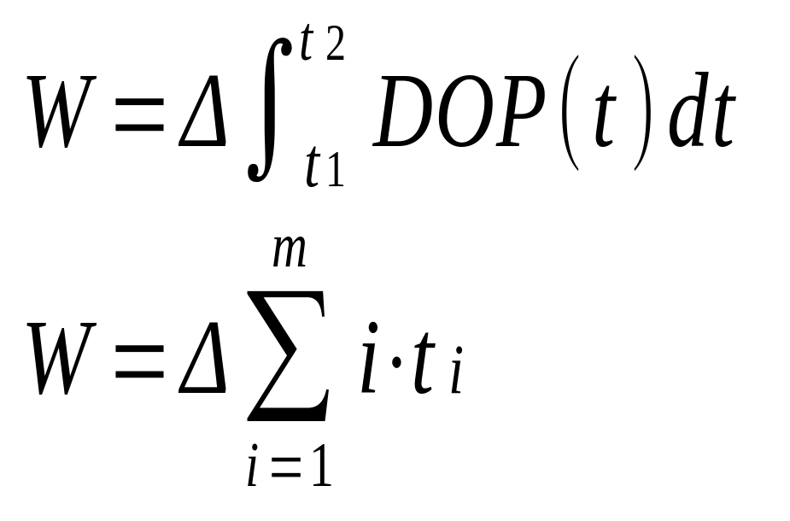
Average parallelism
Total amount of work performed is proportional to the area under the profile curve
EENG-630 Chapter 3

Slide 7
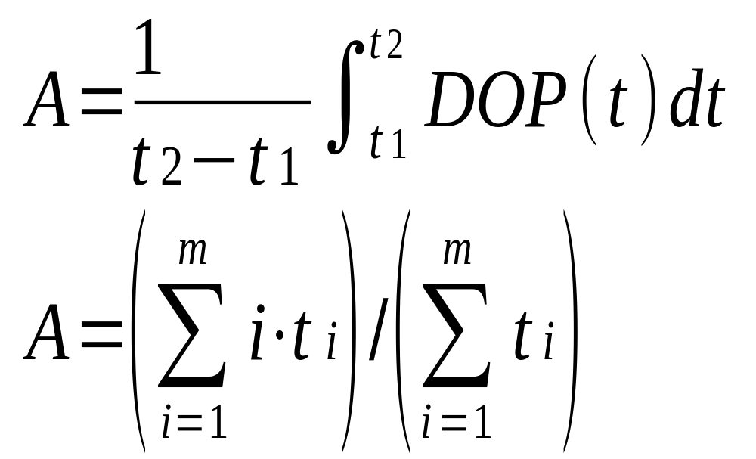
Average parallelism
EENG-630 Chapter 3

Slide 8
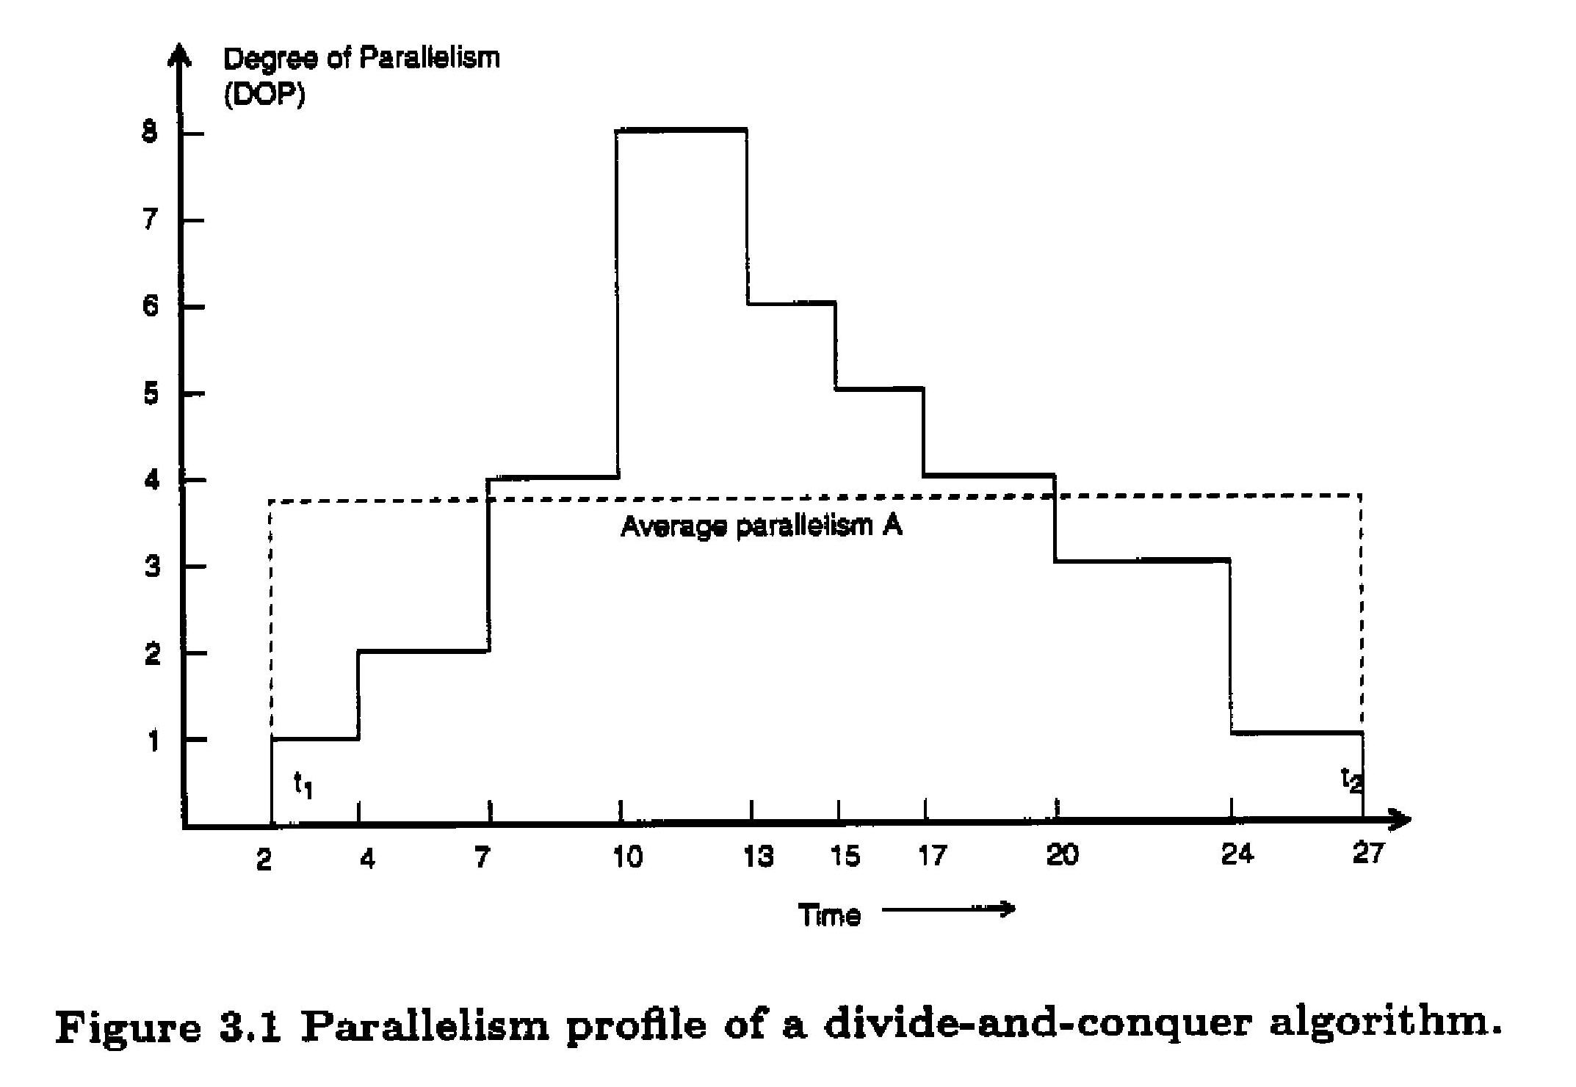
Example: parallelism profile and average parallelism
EENG-630 Chapter 3

Slide 9
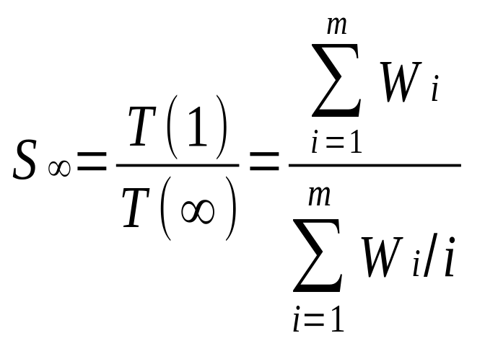
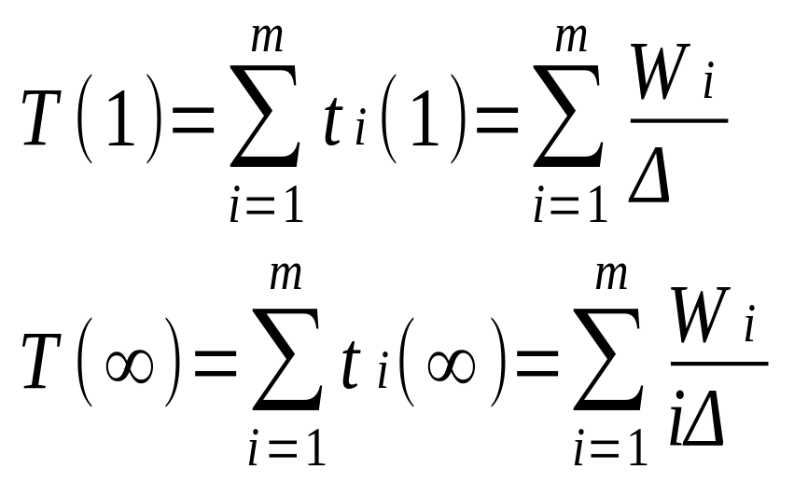
Asymptotic speedup
= A in the ideal case
(response time)
EENG-630 Chapter 3

Slide 10
Performance measures
Consider n processors executing m programs in various modes
Want to define the mean performance of these multimode computers:
  Arithmetic mean performance
  Geometric mean performance
  Harmonic mean performance
EENG-630 Chapter 3

Slide 11
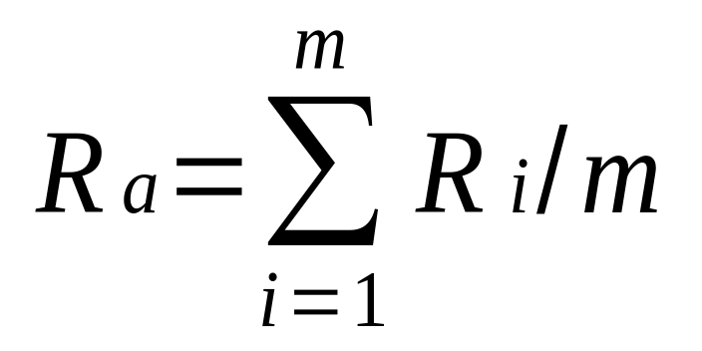
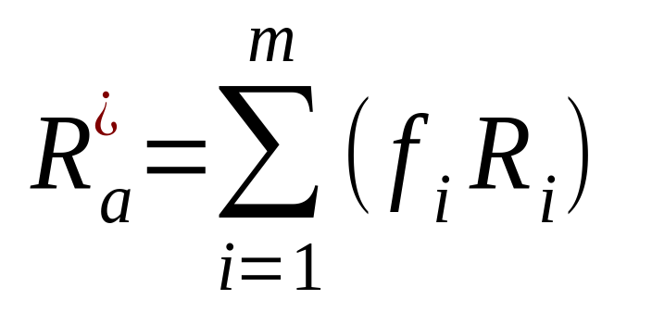
Arithmetic mean performance
Arithmetic mean execution rate
(assumes equal weighting)
Weighted arithmetic mean
execution rate
proportional to the sum of the inverses of
execution times
EENG-630 Chapter 3

Slide 12
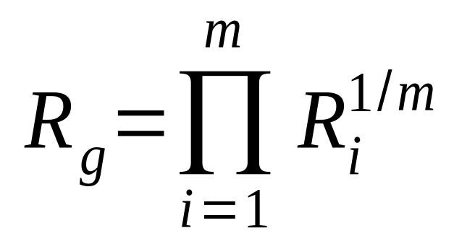
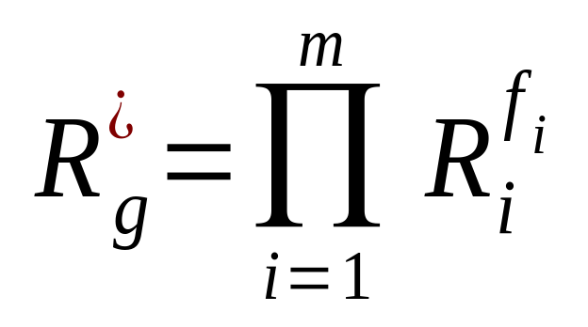
Geometric mean performance
Geometric mean execution rate
Weighted geometric mean
execution rate
does not summarize the real performance since it does
not have the inverse relation with the total time
EENG-630 Chapter 3

Slide 13
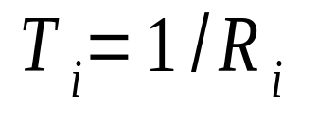
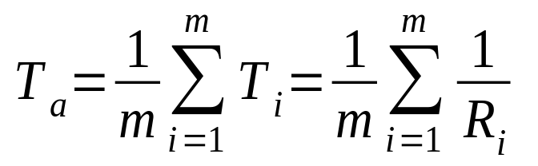

Harmonic mean performance
Mean execution time per instruction
For program i
Arithmetic mean execution time
per instruction
Def - harmonic mean can be expressed as the reciprocal of the arithmetic mean of the reciprocals of the given set of observations. As a simple example, the harmonic mean of 1, 4, and 4 is
EENG-630 Chapter 3

Slide 14
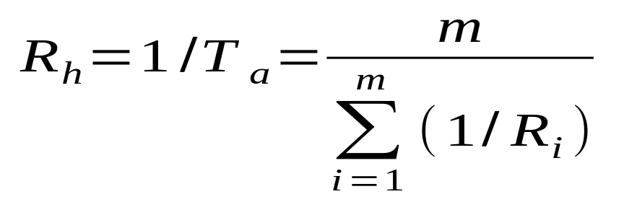
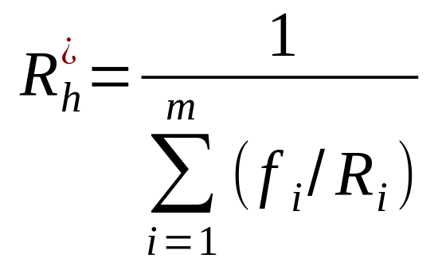
Harmonic mean performance
Harmonic mean execution rate
Weighted harmonic mean execution rate
corresponds to total # of operations divided by
the total time (closest to the real performance)
EENG-630 Chapter 3

Slide 15
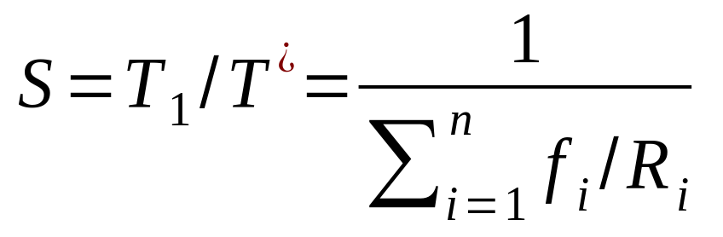
Harmonic Mean Speedup
Ties the various modes of a program to the number of processors used
Program is in mode i if i processors used
Sequential execution time T₁ = 1/R₁ = 1
EENG-630 Chapter 3

Slide 16
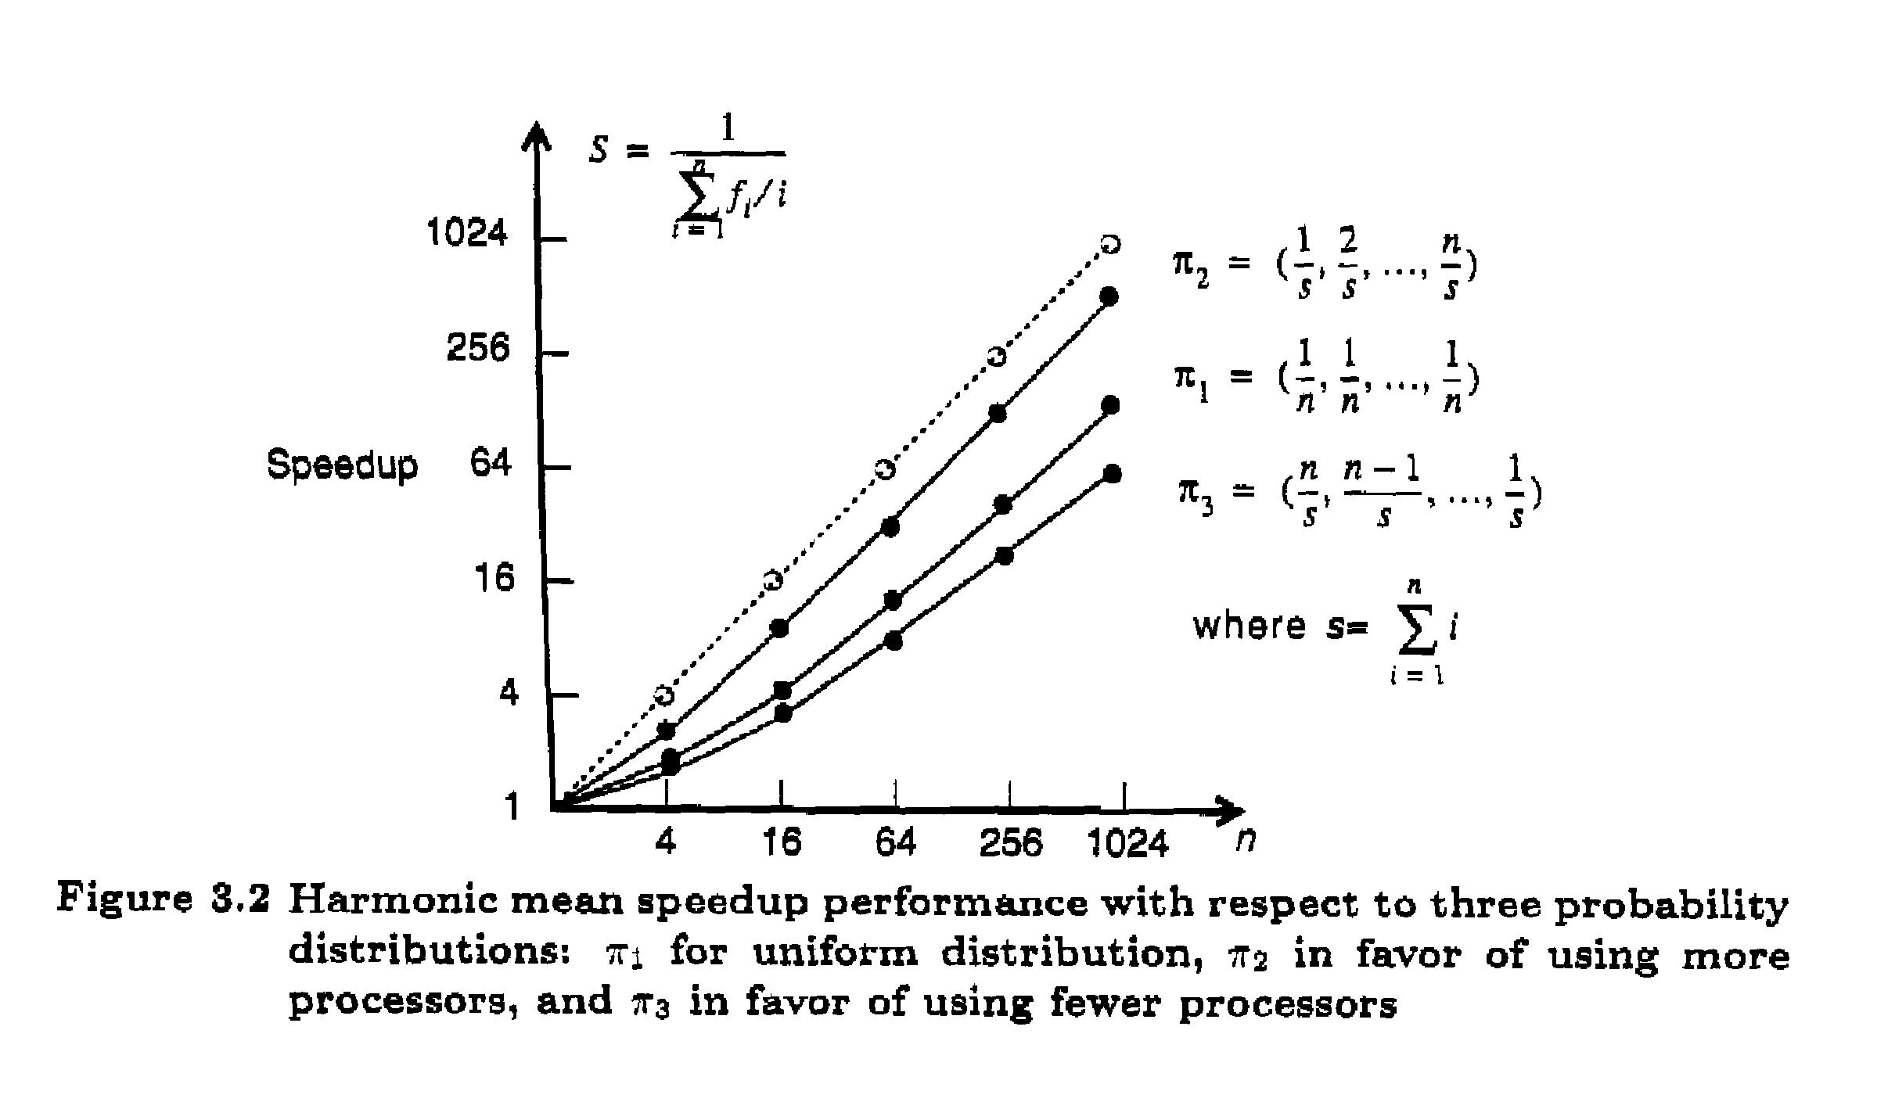
Harmonic Mean Speedup Performance
EENG-630 Chapter 3

Slide 17
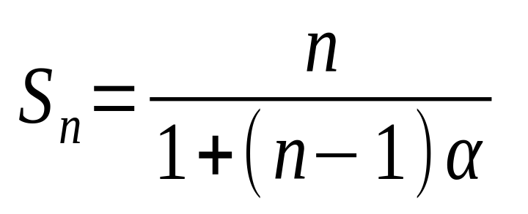
Amdahl’s Law
Assume R_{i} = i, w = (α, 0, 0, …, 1- α)
System is either sequential, with probability α, or fully parallel with prob. 1- α
Implies S → 1/ α as n → ∞
EENG-630 Chapter 3

Slide 18
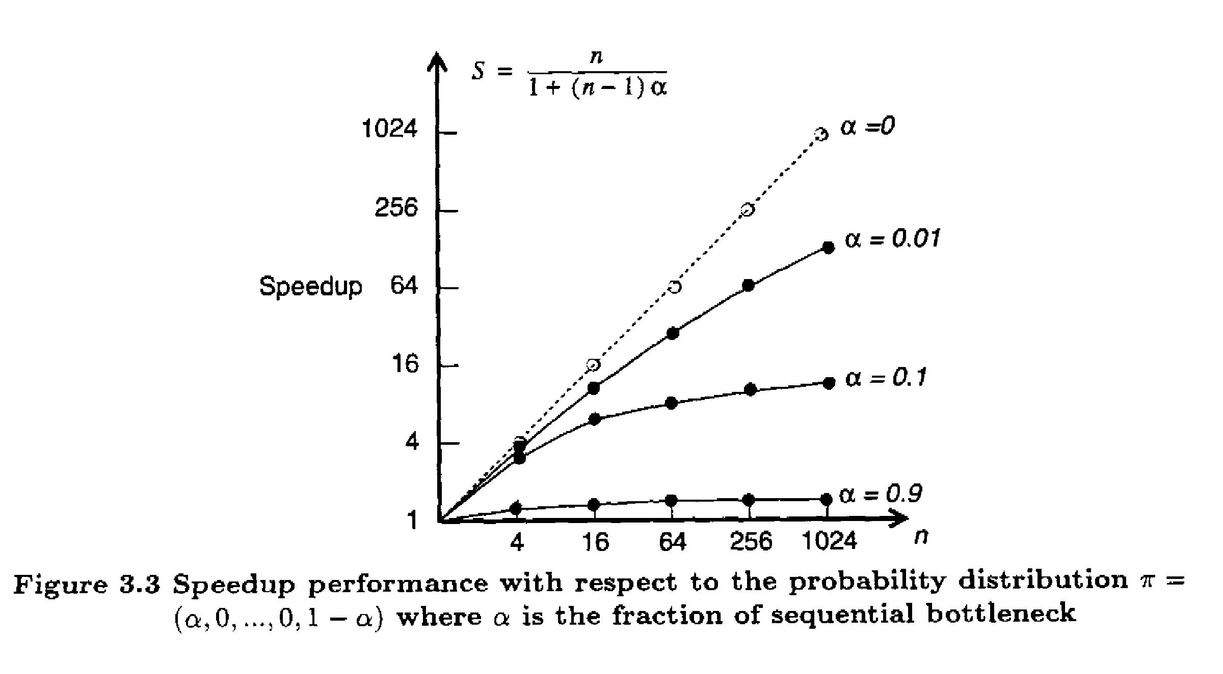
Speedup Performance
EENG-630 Chapter 3

Slide 19
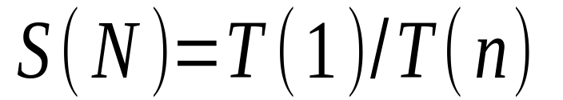
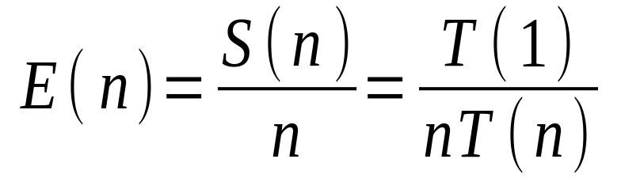
System Efficiency
O(n) is the total # of unit operations
T(n) is execution time in unit time steps
T(n) < O(n) and T(1) = O(1)
EENG-630 Chapter 3

Slide 20
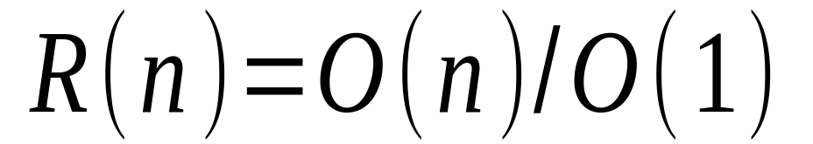
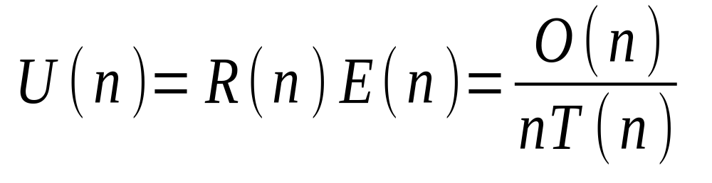
Redundancy and Utilization
Redundancy signifies the extent of matching software and hardware parallelism
Utilization indicates the percentage of resources kept busy during execution
EENG-630 Chapter 3

Slide 21
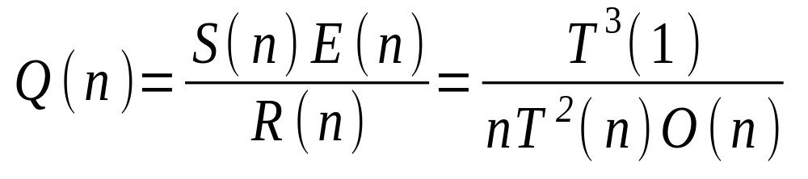
Quality of Parallelism
Directly proportional to the speedup and efficiency and inversely related to the redundancy
Upper-bounded by the speedup S(n)
EENG-630 Chapter 3

Slide 22
Summary of Definitions
S(n) - Degree of speed gain in parallel computation
E(n) - Useful portion of the total work performed by n processors
R(n) - Extent of workload increase.
U(n) - Extent to which resources are utilized in parallel computation
Q(n) - Combines effects of speedup, efficiency and redundancy into a single expression.
EENG-630 Chapter 3

Slide 23
Example of Performance
Given O(1) = T(1) = n³, O(n) = n³ + n²log n, and T(n) = 4 n³/(n+3)
  S(n) = (n+3)/4
  E(n) = (n+3)/(4n)
  R(n) = (n + log n)/n
  U(n) = (n+3)(n + log n)/(4n²)
  Q(n) = (n+3)² / (16(n + log n))
EENG-630 Chapter 3

Slide 24
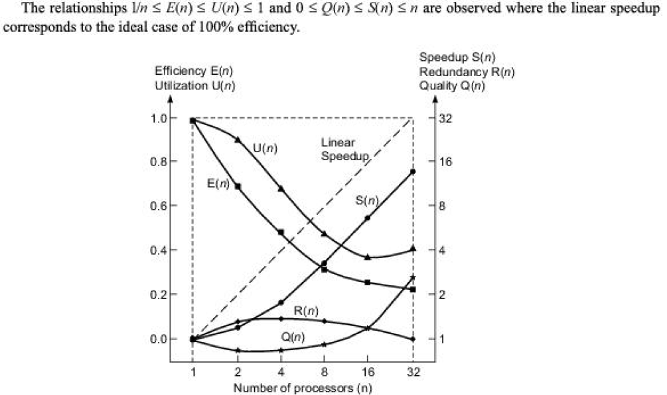
EENG-630 Chapter 3

Slide 25
Standard Performance Measures
MIPS and Mflops
  Depends on instruction set and program used
Dhrystone results
  Measure of integer performance
Whestone results
  Measure of floating-point performance
TPS and KLIPS ratings
  Transaction performance and reasoning power
EENG-630 Chapter 3

Slide 26
Parallel Processing Applications
Drug design
High-speed civil transport
Ocean modeling
Ozone depletion research
Air pollution
Digital anatomy
EENG-630 Chapter 3

Slide 27
Application Models for Parallel Computers
Fixed-load model
  Constant workload
Fixed-time model
  Demands constant program execution time
Fixed-memory model
  Limited by the memory bound
EENG-630 Chapter 3

Slide 28
Algorithm Characteristics
Deterministic vs. nondeterministic
Computational granularity
Parallelism profile
Communication patterns and synchronization requirements
Uniformity of operations
Memory requirement and data structures
EENG-630 Chapter 3

Slide 29
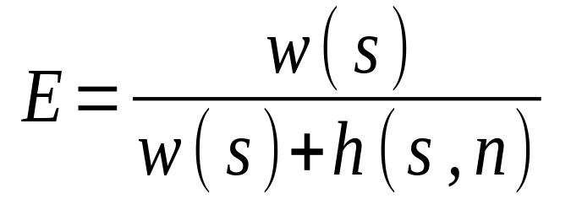
Isoefficiency Concept
Relates workload to machine size n needed to maintain a fixed efficiency
The smaller the power of n, the more scalable the system
workload
overhead
EENG-630 Chapter 3

Slide 30
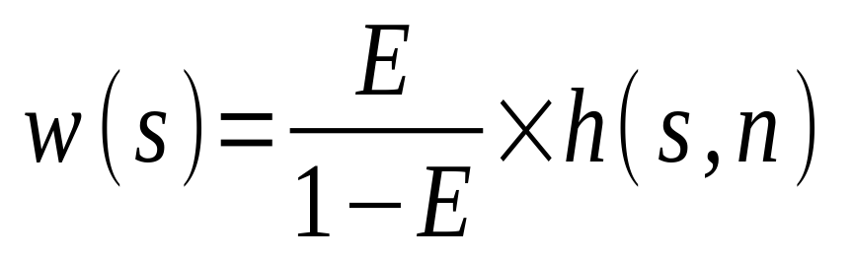
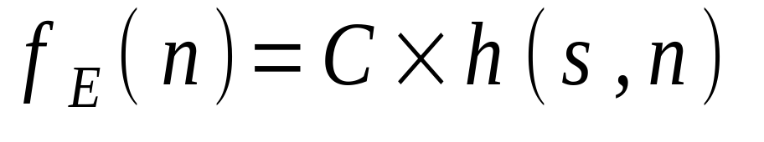
Isoefficiency Function
To maintain a constant E, w(s) should grow in proportion to h(s,n)
C = E/(1-E) is constant for fixed E
EENG-630 Chapter 3

Slide 31
Speedup Performance Laws
Amdahl’s law
  for fixed workload or fixed problem size
Gustafson’s law
  for scaled problems (problem size increases with increased machine size)
Speedup model
  for scaled problems bounded by memory capacity
EENG-630 Chapter 3

Slide 32
Amdahl’s Law
As # of processors increase, the fixed load is distributed to more processors
Minimal turnaround time is primary goal
Speedup factor is upper-bounded by a sequential bottleneck
Two cases:
  DOP < n
  DOP ≥ n
EENG-630 Chapter 3

Slide 33
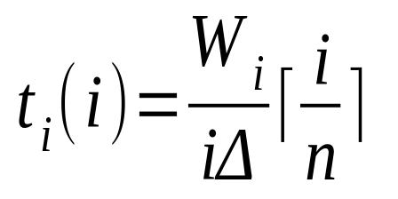
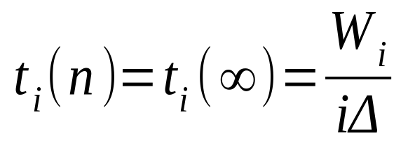
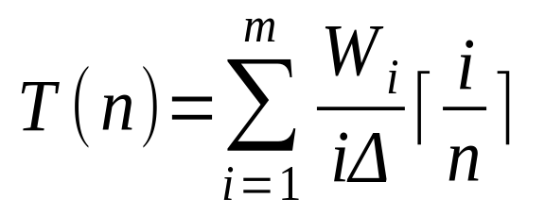
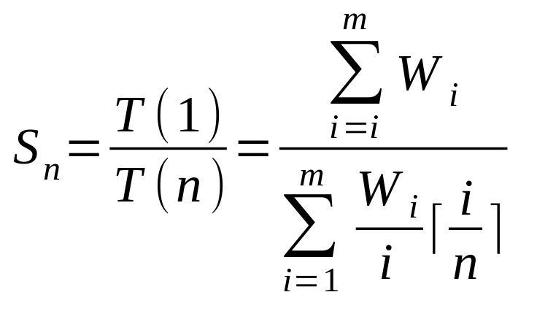
Fixed Load Speedup Factor
Case 1: DOP > n
Case 2: DOP < n
EENG-630 Chapter 3

Slide 34
Gustafson’s Law
With Amdahl’s Law, the workload cannot scale to match the available computing power as n increases
Gustafson’s Law fixes the time, allowing the problem size to increase with higher n
Not saving time, but increasing accuracy
EENG-630 Chapter 3

Slide 35
Fixed-time Speedup
As the machine size increases, have increased workload and new profile
In general, W_{i}’ > W_{i} for 2 ≤ i ≤ m’ and W₁’ = W₁
Assume T(1) = T’(n)
EENG-630 Chapter 3

Slide 36
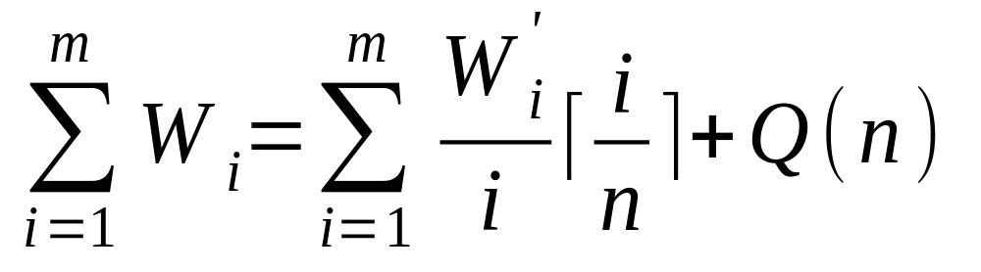
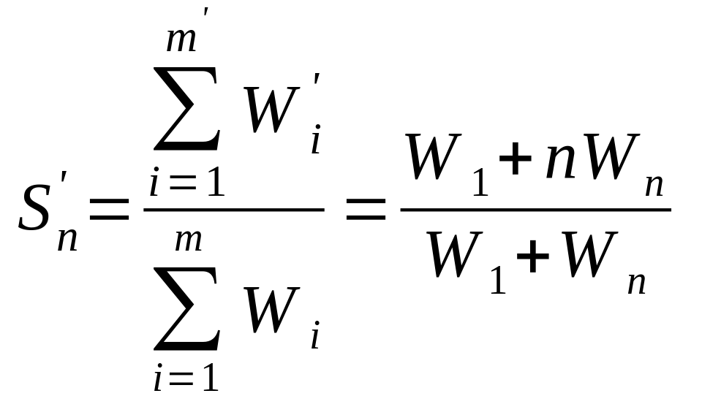
Gustafson’s Scaled Speedup
EENG-630 Chapter 3

Slide 37
Memory Bounded Speedup Model
Idea is to solve largest problem, limited by memory space
Results in a scaled workload and higher accuracy
Each node can handle only a small subproblem for distributed memory
Using a large # of nodes collectively increases the memory capacity proportionally
EENG-630 Chapter 3

Slide 38
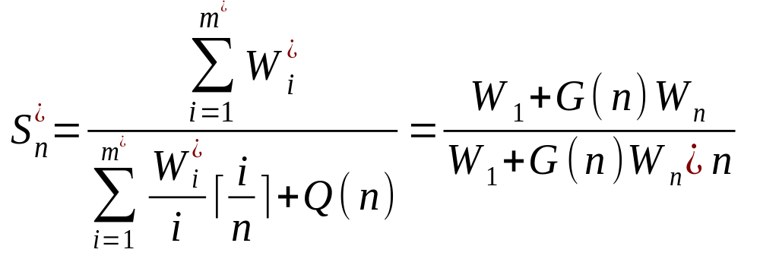
Fixed-Memory Speedup
Let M be the memory requirement and W the computational workload: W = g(M)
g*(nM)=G(n)g(M)=G(n)W_{n}
EENG-630 Chapter 3

Slide 39
Relating Speedup Models
G(n) reflects the increase in workload as memory increases n times
G(n) = 1 : Fixed problem size (Amdahl)
G(n) = n : Workload increases n times when memory increased n times (Gustafson)
G(n) > n : workload increases faster than memory than the memory requirement
EENG-630 Chapter 3

Slide 40
Scalability Metrics
Machine size (n) : # of processors
Clock rate (f) : determines basic m/c cycle
Problem size (s) : amount of computational workload. Directly proportional to T(s,1).
CPU time (T(s,n)) : actual CPU time for execution
I/O demand (d) : demand in moving the program, data, and results for a given run
EENG-630 Chapter 3

Slide 41
Scalability Metrics
Memory capacity (m) : max # of memory words demanded
Communication overhead (h(s,n)) : amount of time for interprocessor communication, synchronization, etc.
Computer cost (c) : total cost of h/w and s/w resources required
Programming overhead (p) : development overhead associated with an application program
EENG-630 Chapter 3

Slide 42
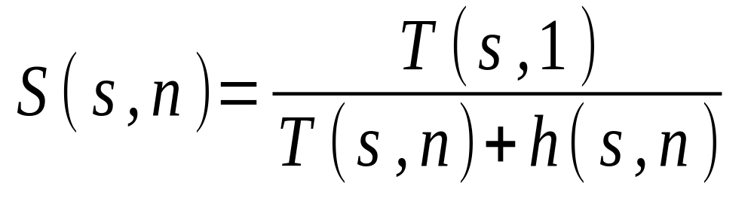
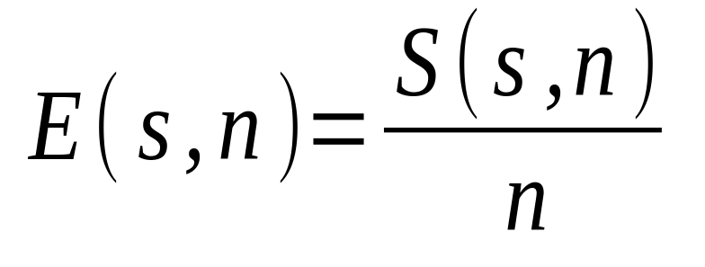
Speedup and Efficiency
The problem size is the independent parameter
EENG-630 Chapter 3

Slide 43
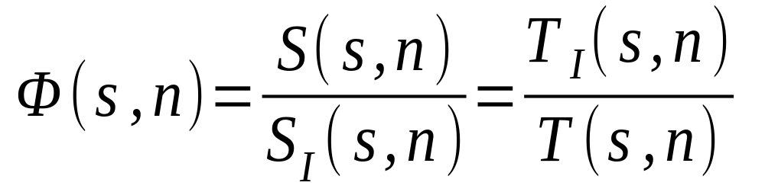
Scalable Systems
Ideally, if E(s,n)=1 for all algorithms and any s and n, system is scalable
Practically, consider the scalability of a m/c
EENG-630 Chapter 3

